Slide 1

Speech emotion recognition with librosa
By Sashank Bommadevara
CWID: A20491471

Slide 2
Objective of this project
To build a model to recognize emotion from speech using the librosa and sklearn libraries and the RAVDESS dataset.

Slide 3
Motivation
Have you ever used a telephone service? How did you find the experience? When you have a robot asking you questions, it may be really annoying. Assume you are unhappy and decide to phone the firm again, only to be met with a robot on the other end of the line. That is an example of how you could use machine learning to understand speech emotion and enhance customer service. Adding emotions to robots has been identified as a vital step in making machines seem and behave like humans.
The goal of this project is to create an emotion recognizer from voice data using the librosa audio analysis package.

Slide 4
Speech Emotion Recognition
Speech emotion recognition is the process of trying to identify affective and emotional states in human speech. This makes use of the fact that tone and pitch in the voice frequently convey underlying emotion. In order to comprehend human emotion, animals like dogs and horses also use this phenomenon.
The relevance of emotion recognition is growing as user experience and the use of Voice User Interfaces improve (VUIs). Creating emotion recognition systems based on speech has practical applications. However, when the system is used in actual applications, the real-world background noise impairs the effectiveness of speech-based emotion identification.

Slide 5
Usage of Speech Emotion Recognition
SER(Speech Emotion Recognition) is used in call center for classifying calls according to emotions and can be used as the performance parameter for conversational analysis thus identifying the unsatisfied customer, customer satisfaction and so on.. for helping companies improving their services
It can also be used in-car board system based on information of the mental state of the driver can be provided to the system to initiate his/her safety preventing accidents to happen
Telemedical Application to know the Mental state of the caller.

Slide 6
About librosa
A Python module called librosa is used to analyze audio and music. It standardizes interfaces and names, provides a flatter package layout, backwards compatibility, modular functions, and readable code. Additionally, we show how to install it (as well as a few other packages) using pip in this Python mini-project.
To install librosa use the below command:
pip install librosa

Slide 7
Environment used in this project
IDE: Jupyter Notebook by Anaconda
Language: Python 3.9
OS: Windows 11
Libraries used: librosa, soundfile, numpy, sklearn, pyaudio

Slide 8
The Dataset
We'll utilize the RAVDESS dataset, which is available for free download and stands for Ryerson Audio-Visual Database of Emotional Speech and Song, for this Python mini-project. In this dataset, 7356 files were evaluated on emotional validity, intensity, and sincerity by 247 people ten times. The complete dataset, consisting of 24 actors, weighs in at 24.8GB, but we've reduced the sample rate across the board.
Dataset download link:
https://www.kaggle.com/datasets/uwrfkaggler/ravdess-emotional-speech-audio

Slide 9
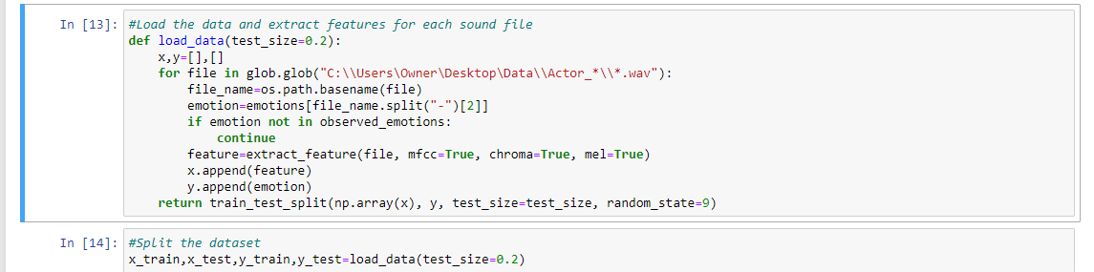
Code

Slide 10
Getting dataset to ready for our model
The input and the output variables are separated in variables ‘x’ and ‘y’.
Choose only necessary features and remove the redundant ones.
Loaded the dataset in the IDE and split the dataset into 80% train and 20% test.

Slide 11
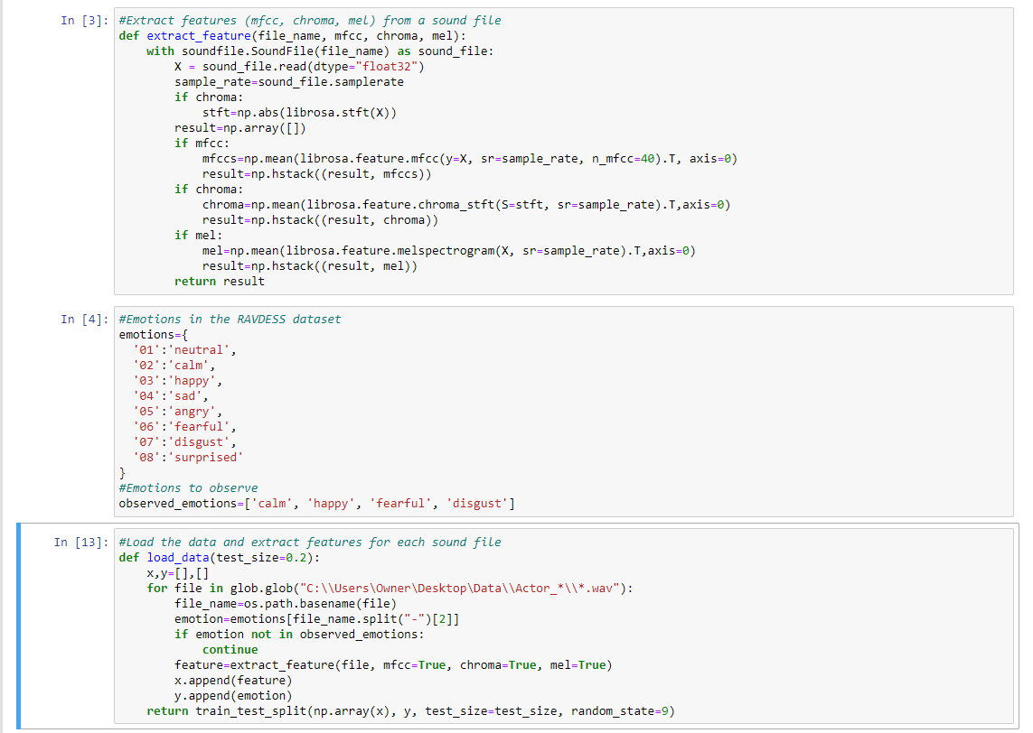
Code

Slide 12
Extract Features Definition
MFCC: Mel Frequency Cepstral Coefficient, represents the short-term power spectrum of a sound.
Chroma: Chroma is a method of converting sounds into numerical numbers. Most of the time, Chroma can be converted to a vector data format. A overview of Chroma history comprises the feature extraction process and can become an important aspect of data engineering. Chroma is a 12-element vector that calculates energy based on sound pitch.
STFT: Short-Time Fourier Transform
Mel: Spectrogram Frequency

Slide 13
Initialize the Multi Layer Perceptron Classifier
This multi-layer perceptron classifier uses stochastic gradient descent or LBFGS to optimize the log-loss function. The MLPClassifier uses an internal neural network for classification, unlike SVM or Naive Bayes. This ANN model is feedforward ANN model.
After initializing the model, we fit the data and train the model.

Slide 14
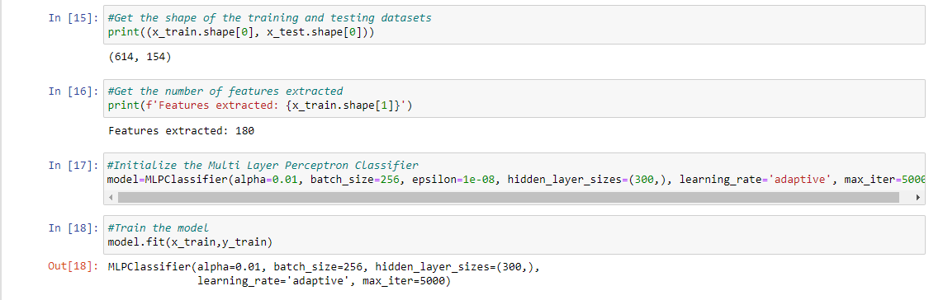
Code

Slide 15
Getting predictions
After training the model check for its performance using the test data by making necessary predictions.
The final achieved accuracy is: 75%

Slide 16
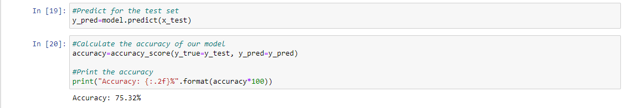
Code

Slide 17
Conslusion
Hence, the MLP Classifier achieved good accuracy and satisfied in prediction of output with minimal loss. So, i conclude that the MLP Classifier is one of the speech recognition model which can yield good results.

Slide 18
Future Work
To Build a model that can identify emotion from Natural speech instead of professional environment with minimal noise and environmental interference.

Slide 19
Thank you !
Your queries will be answered now

